Slide 1
Notes:
[Blank??] Bought a Sinar camera … did experiments …. Saw problems

Slide 2
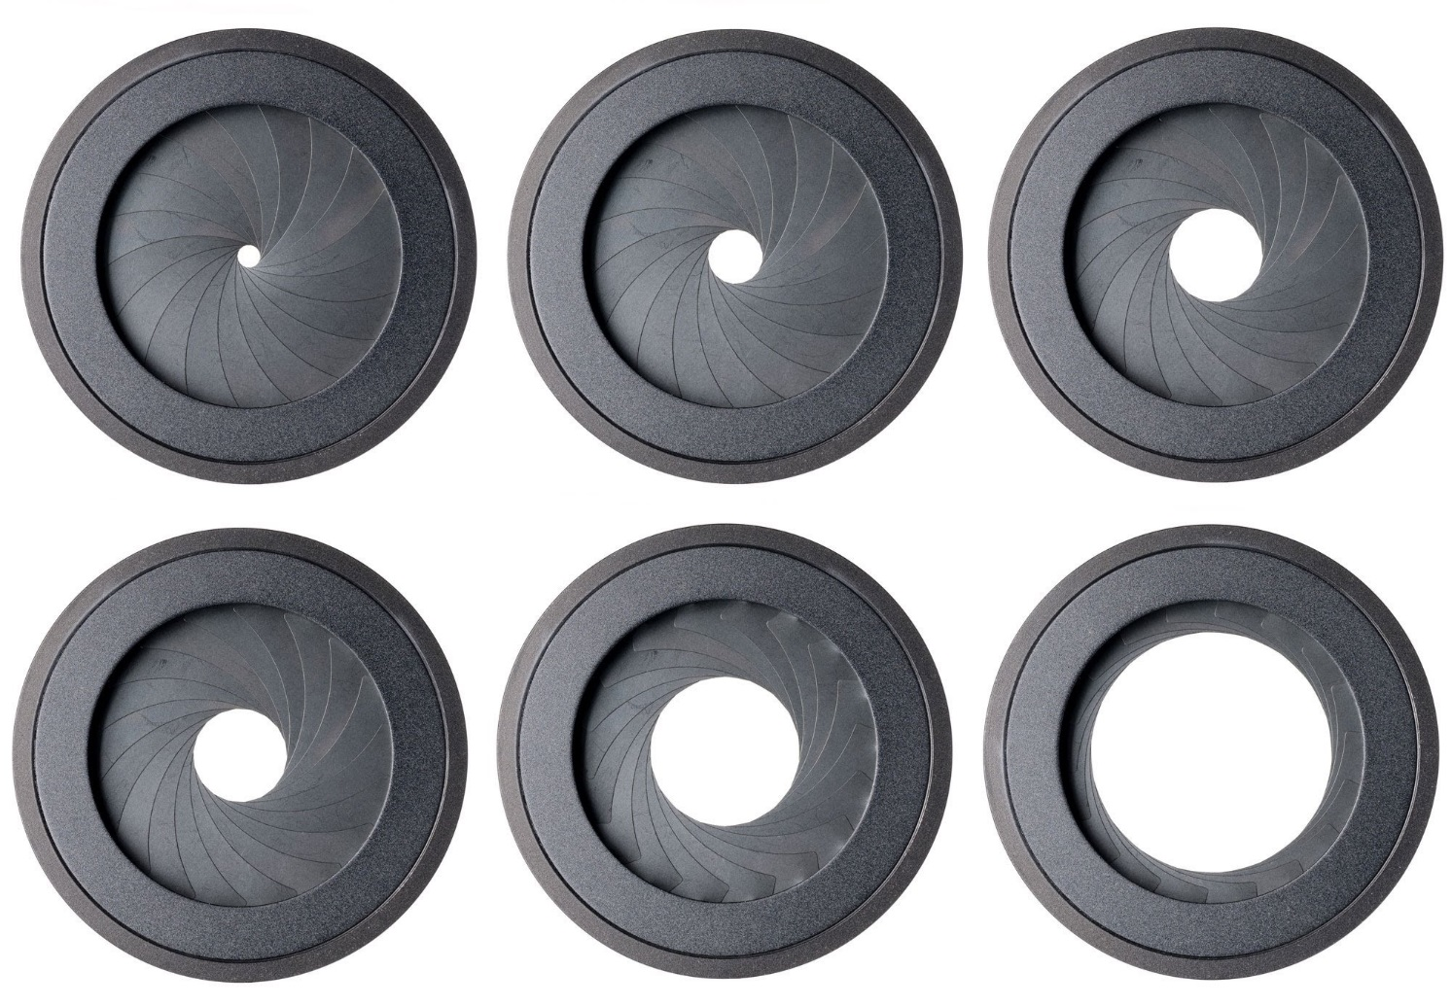
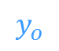


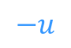
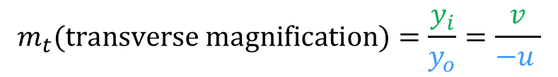

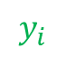
Chief rays from the object space to the image space defines the image shape
Aperture (stop)
Image plane
Object
$$\text{x}$$
Chief ray
$$y_{o}$$
Optical axis
$$y_{i}$$
$$−u$$
$$v$$
Image
$$\acute{\text{x}}$$
Use of similar triangles:
$$m_{t}\text{(}\text{transverse} \text{magnification}\text{)}=\frac{y_{i}}{y_{o}}=\frac{v}{−u }$$
Notes:
The chief ray is the ray from the object point to the image point that passes through the center of the aperture. As seen in the figure, the intersection of the chief ray with the image plane determines the heigh of the image point. Therefore, for an extended object that consists of a set of points, the set of chief rays from the object space to the image plane determines the geometric properties of the image. We can find all relationships by applying similar traiangles.
Furthermore, since all chief rays

Slide 3
Center of perspective: the chief rays from the object space converge at the center of the aperture
Aperture (stop)
Image plane
Chief rays
Object
Object
Image
Chief rays
Aperture (stop)
Image plane
Image
Notes:
The chief ray is the ray from the object point to the image point that passes through the center of the aperture. As seen in the figure, the intersection of the chief ray with the image plane determines the heigh of the image point. Therefore, for an extended object that consists of a set of points, the set of chief rays from the object space to the image plane determines the geometric properties of the image. We can find all relationships by applying similar traiangles.
Furthermore, since the chief rays from the object converge at the center of the aperture, the center of the aperture is the “center of perspective projection” … in otherwords, if we change the location of the aperture’s center, a different set of rays from the object becomes the chief rays, and we

Slide 4
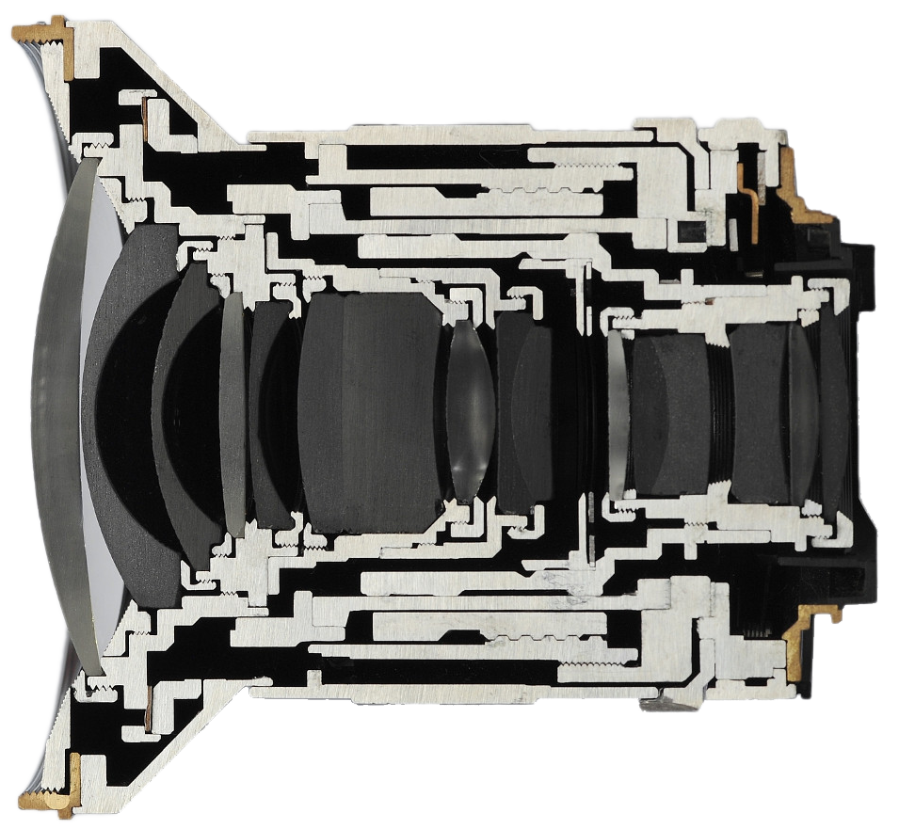
Real lenses have several refracting surfaces on either side of the aperture (stop)
Lens elements
in front of the aperture
Lens elements behind the aperture
Aperture
Cross-section of Zeiss Distagon 21mm F/2.8
[Photograph from ilovehatephoto.com]

Slide 5
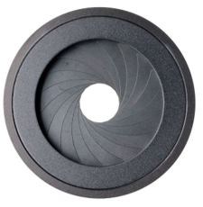
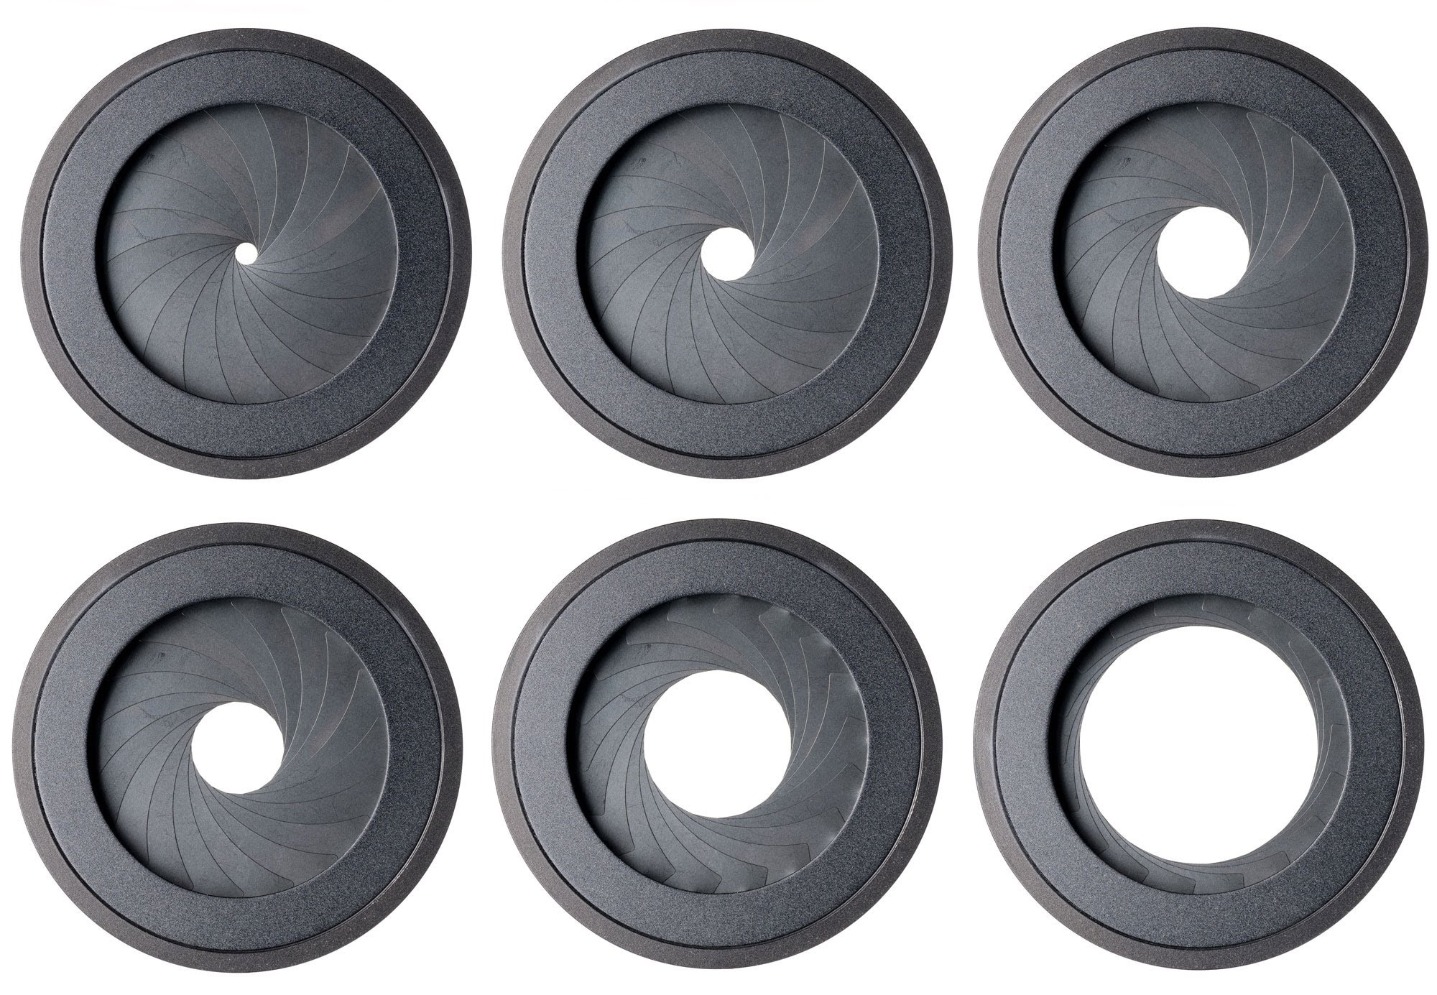
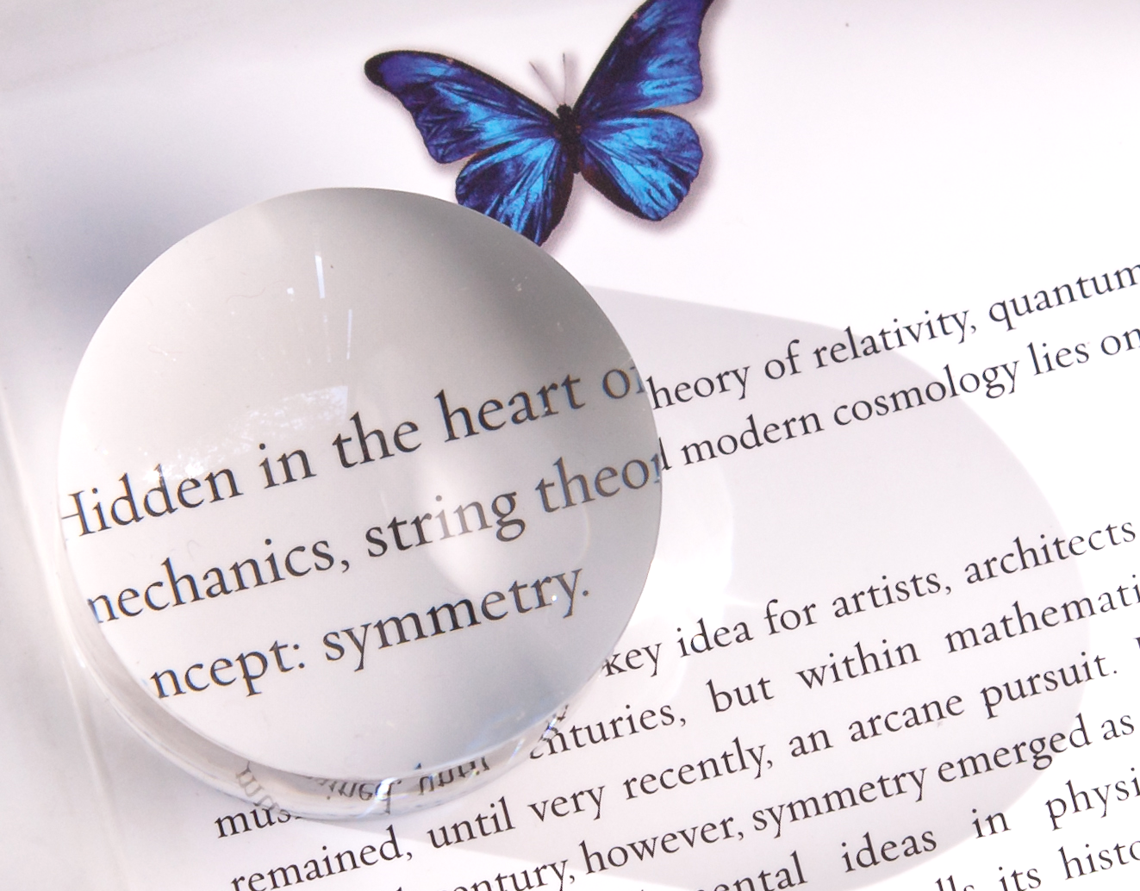
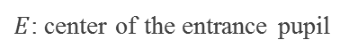
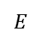
xxxxxxx
Front view
+
Side view
$$E$$
Marginal ray
Aperture (stop)
Entrance pupil
$E$: center of the entrance pupil
Notes:
When we hold a magnifying glass over some text, the text looks magnified. Most of us will remember, the lens forms a virtual and enlarged image of the text behind the text. Similarly, when we place refracting elements in front of the aperture, we usually see a magnified image of the physical stop that is located behind the physical stop.
In the same way, when the chief rays from the

Slide 6
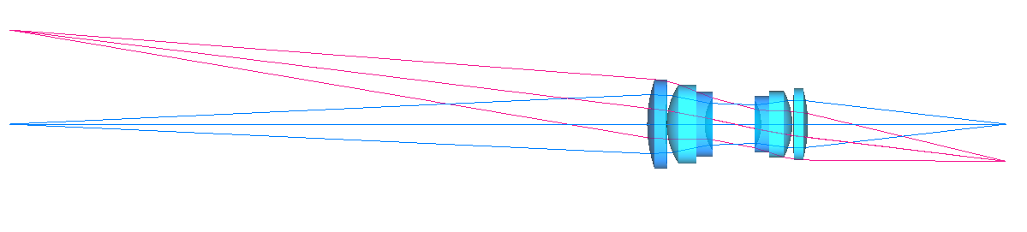
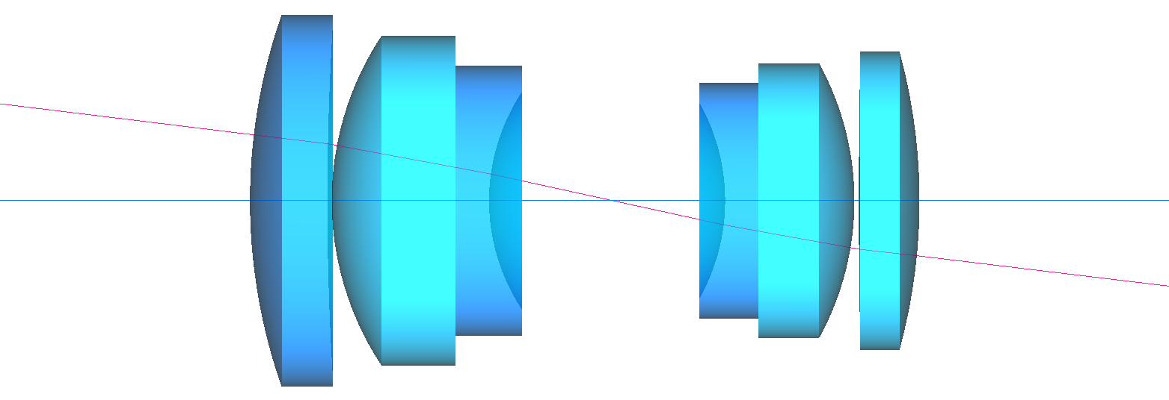
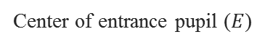
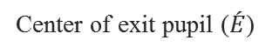
The “entrance pupil” is the image of the stop formed by the front lens elements
and the “exit pupil” is the image of the stop formed by the rear lens elements
Chief ray
Aperture (stop)
Object
Chief ray
Image
~361 mm
~144 mm
A double gauss lens (f = 102 mm) ▴
Exit pupil
Entrance pupil
Chief ray
Stop
Center of entrance pupil ($E$)
Center of exit pupil ($\acute{E}$)
Notes:
Here is a widely popular lens design called the Double Gauss, with a few rays traced from the two extreme points of an object. The image shows the chief rays, the marginal rays, and the lens consisting of refracting elements in front and behind the aperture.
The zoomed in figure shows the location of the entrance pupil, which is the image of the aperture formed due to the lens elements on the object side, and the exit pupil, which is the image of the aperture formed due to the lens elements on the image side. I found the locations and the size of the images using Zemax.
Futhermore, if we concentrate on the chief rays, we can see that the chief rays from the object side entering the lens appear to converge towards the center of the entrance pupil, and the corresponding chief rays going away from the lens towards the image plane, appear to diverge from the center of the exit pupil.
Now, because the angle of the chief ray going towards the image plane will determine the height—and therefore the geometric properties—of the image, a question to ask is whether the chief ray entering the lens and and the corresponding chief ray exiting the lens are parallel?

Slide 7
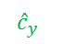
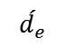


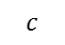
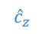
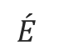
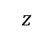
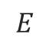
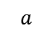
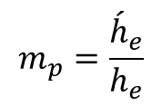

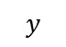
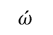

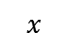
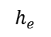
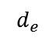
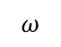
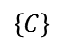
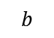
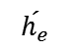
Nothing in optics makes sense except in the light of the pupils
Exit pupil
Entrance pupil
Chief ray (input)
$$h_{e}$$
$$\acute{h_{e}}$$
$$\text{x}$$
$$l$$
$${\hat{c}}_{y}$$
$$ω$$
$$E$$
$$\left\{C\right\}$$
$$\acute{E}$$
Optical axis
$${\hat{c}}_{z}$$
$$\acute{ω}$$
$$\acute{l}$$
Chief ray (output)
Lens pivot & origin of camera coordinate frame
$$d_{e}$$
$$\acute{d_{e}}$$
$$z$$
Pupil magnification:
$$c$$
Direction cosine
$$b$$
$$m_{p}=\frac{{\acute{h}}_{e}}{h_{e}}$$
$$y$$
$$a$$
$$l= <\cos{a},\cos{b},\cos{c}>$$
$$x$$
Notes:
But before we get there, lets introduce … how w
Talk about the abstraction of lens, and the pupil magnification.

Slide 8
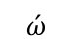
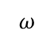

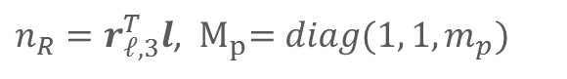

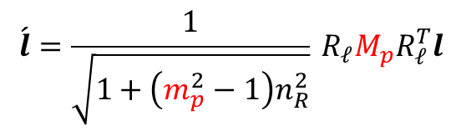
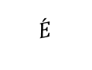
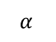
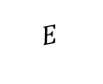
The pupil magnification $m_{p}$ changes the chief ray’s direction cosine
in the image space
Exit pupil
Entrance pupil
Chief ray
$$\text{x}$$
$${\hat{c}}_{y}$$
$$l$$
$$\left\{C\right\}$$
$$\acute{E}$$
$$\acute{ω}$$
$$α_{ }$$
$$ω$$
$${\hat{c}}_{z}$$
$$E$$
OPTICAL AXIS
$$\acute{l}$$
Lens pivot & origin of camera coordinate frame
$$\acute{l}=\frac{1}{\sqrt{1+\left(m_{p}^{2}−1\right)n_{R}^{2}}}{}_{ }^{ }{R_{𝓁}}M_{p}R_{𝓁}^{T}l$$
Chief ray’s direction cosine at the input (object space)
Chief ray’s direction cosine at the output (image space)
$n_{R}=r_{𝓁,3}^{T}l$, ${ M}_{p}=diag(1, 1, m_{p})$
Notes:
The first step in bu
.. The pivot of the lens is the center of the camera coordinate system

Slide 9
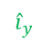


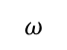
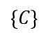
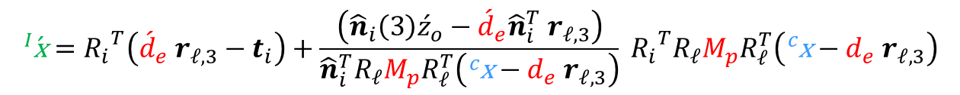
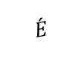
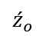
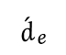
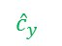
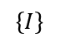
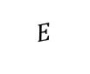








xxxxxxxxxxxxxxxxxxxxxxxxxxxxxxxxxxxxxxxxxxxxxxxxx
Chief ray
Exit pupil
$${\hat{n}}_{i}$$
Pivots
Entrance pupil
$$\text{x}$$
$${\hat{c}}_{y}$$
$${\hat{i}}_{y}$$
$$l$$
$$\acute{E}$$
$${\hat{i}}_{x}$$
$$\left\{C\right\}$$
$$\acute{ω}$$
$$α_{ }$$
$$ω$$
$${\hat{c}}_{z}$$
$$\left\{I\right\}$$
$$E$$
$$\acute{l}$$
OPTICAL AXIS
$$\acute{\text{x}}$$
$${\acute{d}}_{e}^{ }$$
$$d_{e}$$
$${\acute{z}}_{o}^{ }$$
Image plane
$$\begin{aligned}{}_{ }^{I}{\acute{\text{x}}}=&{R_{i}}^{T}\left({\acute{d}}_{e} r_{𝓁,3}−t_{i}\right)+\frac{\left({\hat{n}}_{i}\left(3\right){\acute{z}}_{o}−{\acute{d}}_{e}{\hat{n}}_{i}^{T} r_{𝓁,3}\right)}{{\hat{n}}_{i}^{T}R_{𝓁}M_{p}R_{𝓁}^{T}\left({}_{ }^{c}{\text{x}}−d_{e} r_{𝓁,3}\right)}{}_{ }^{ }{{R_{i}}^{T}R_{𝓁}}M_{p}R_{𝓁}^{T}\left({}_{ }^{c}{\text{x}}−d_{e} r_{𝓁,3}\right)\end{aligned}$$
Coordinates of image point in image reference frame
Coordinates of object point in camera frame
Notes:
… then we introduce an sensor plane, that can rotate about its independent pivot (at a distance z_o dash) from the pivot of the lens.
The pupil coordinates are highlighted in red

Slide 11


$$\text{x}$$
$$\acute{\text{x}}$$

